Slide 1
Introduction to Connection Oriented Concepts
Inder Monga
Chief Technologist, ESnet
Co-chair, NSI working group
NSI Tutorial @ TIP 2013
January 13th

Slide 2
Lambdas and Lightpaths
Lambda
Wavelength or a physical circuit
Lightpath
Communications channel aka virtual circuit
Connects two points in the network
Has capacity associated with it
Technology agnostic, multiple ways to build a circuit
Network Aruba
Network Curacao
5 Gbps
Lightpath

Slide 3
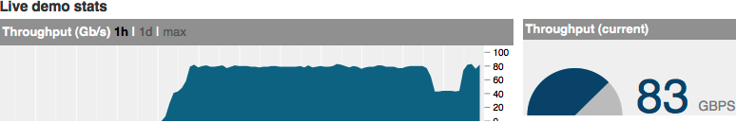
Myth Busters
100
Gbps
Bandwidth:
Maximum capacity of a given lightpath/lambda
Throughput:
How many application bits/second can get carried between any two points of the network
10
Gbps
Network property
From my.es.net
Application or end-to-end property
Notes:
Network as a water pipe, Bandwidth is the maximum water flow

Slide 4

On-Demand
Bandwidth, not throughput
“On-demand” is defined by time-scale
Not O(days or months)
But O(seconds to minutes)
Additional property
Software-controlled
GUI or Application initiated

Slide 5
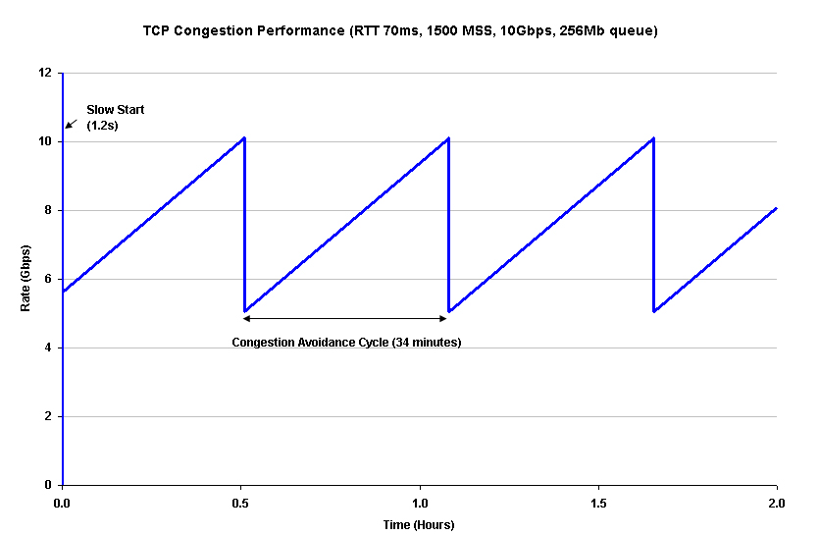
Some more truths
Application can try engineer their end-to-end throughput
Application currently can request point-to-point bandwidth
As supported in many installations today
Focus of first protocol of NSI framework
Point-to-multi-point investigated
Throughput ? Bandwidth
!=
≤
TCP congestion performance
Application A
12 Gbps
Application B
28 Gbps
100 Gbps

Slide 6
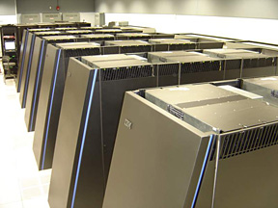

“Guaranteed” Bandwidth
Bandwidth reserved for a single flow or set of application flows (or lightpath)
Edge-to-edge
End-to-end
Related concepts
Best Effort
Public Internet
Oversubscription
Aggregation
ESnet
BNL
NERSC
Notes:
Look for appropriate images

Slide 7


Styles of Guarantee
Strict or exact
Ceiling
Peak
Floor
Traffic above floor marked for discard if congestion
2Gbps max
Dropped
t →
1Gbps floor
Marked
but not
dropped
Guaranteed
t →

Slide 8
Domains (networks)
Administrative boundaries are broad and can be arbitrary
Single Domain
Single administrative management entity
Multi-domain
Multiple administrative management entities
USLHCnet
BNL
CERN
ESnet

Slide 9
BoD Spans Network Layers
Layer 3/2.5: MPLS
Layer 2: Carrier Eth.
Layer 1: Lightpath/OTN
Layer 0: Wavelength

Slide 10
Scheduling
On-Demand
Time: Now
Duration: Till when I please
Scheduled
Time: Start-time, specific time in the future
Duration: End-time OR time duration

Slide 11
Reservation
Network Resources reserved for a certain application at a certain “schedule”
Bandwidth, Path
On-demand is equivalent to instant bandwidth reservation with no specified end-time

Slide 12
Path-Finding
Two ends of the network
Start = A point
End = Z point
Path
Creating a physical or virtual circuit between points A and Z passing through multiple network devices
Can be single or multi-domain
Multi-layer path-finding a lot more complex than at a single layer
USLHCnet
BNL
CERN
ESnet
A
Z

Slide 13
Unidirectional vs. Bidirectional paths
Most protocols are bidirectional but may not require symmetric reservations
Example: Large data transfer
Two kinds of bidirectional:
Associated
Two unidirectional paths
Complex management, since independent entities
May follow different routes
Co-routed
Forward and backward follow the same route
Usually setup as part of a single operation
Transport paths are typically co-routed

Slide 14
Topology
Map of interconnected devices
Intra-domain
Inter-domain
Network and technology characteristics
Can represent the physical layer limitations
Notes:
What’s possible

Slide 15
Topology (contd.)
Virtual topologies refer to logical connections or limited subsets of the physical topology
Physical topology is the most straightforward
Which port, node, location, etc.

Slide 16
Path Computation Engine (PCE)
Choose a path based on Topology, current network state and certain criteria
Current network state
Available capacity and resource commitments
Includes reservations in the future
Criteria
Bandwidth
Layer
Latency
Green energy
Your favorite metric

Slide 17
Modify
Ability to change certain parameters of the reservation
May or may not cause service outage
Focus on a very limited set of parameters
Modify can be powerful for applications facing a varying workload
Can only be implemented at Layer 2 or above in the network
Duration is typically the most modified parameter where the connection remains the same
Bandwidth is the next most common

Slide 18
Bandwidth vs Connection on-Demand
Bandwidth-on-demand does not have to mean a new connection setup
~0 bandwidth circuits
Use modify to add bandwidth, if available
Connection-on-demand is what most of us refer to as BoD
Provisioning and teardown of new connections are more resource intensive
Question – What suits your purpose?

Slide 19

Limitations

Slide 20
Physical Infrastructure
Most applications not familiar with the topology might assume BoD capabilities that is not physically possible
For example:
40G NIC on application host, 10G WAN connectivity of DC
Can’t do 40G flows over nx10G connectivity

Slide 21
Site Network Architecture Science DMZ design patterns
Science DMZ
Abstract Design
Supercomputer Center
Data Site

Slide 22
Blocking
‘Guaranteed Reservations’ of other applications might consume all resources
Even though the traffic profile indicates a lot of headroom
Some of these reservations might be scheduled
Similar to hotel reservation
An intermediate network domain might have resource constraints
Path finding needs to be intelligent
Path computation may take a lot of cycles if networks are ‘reservation congested’

Slide 23
Putting it all together
Multi-layer, multi-domain, multi-vendor, On-Demand, Bandwidth Scheduling and Reservation Service
Service is the most important aspect, protocols only are building blocks

Slide 24
What else is needed for a service?
Authorization and Authentication, Trust
Global federated system that works well with applications
Service Level Agreements
What is the lowest common denominator across the multi-domain network?
Service Definition
Consistent view of the end-to-end service
Homogenous service over heterogeneous technologies
Monitoring and measurement
End-to-end as well
Multi-domain debugging
How do you find errors, report them so they can be debugged and fixed?

Slide 25

Top to Bottom view
NSI
Service Plane:
End-to-end services, application-oriented
Management Plane:
Provisioning and management of the network devices and as a system
Control Plane:
distributed management of forwarding
Data Plane:
carries real bits, electrical and optical

Slide 26
Questions?
Imonga at es.net

Slide 27
Network Services Interface
Standards process in OGF
Strong participation from NREN community
Notes:
Unproven in scale, AutoGOLE, Topology

Slide 28
Network Service Framework concepts
Network Services Interface (NSI)
Network Service A
Network Service B
Network Service A
Network Service B
Service
Requestor
Service
Provider
NSI Requestor
Agent (RA)
NSI Provider
Agent (PA)
NRM
NSA
NSA
NRM
Service Plane
Transport Plane
Local Resources
Local Resources
* Slides contain animation, does not show in pdf
NSA = Network Services Agent
NRM = Network Resource Manager
Notes:
1. Connection Service, a service used to request and manage transport connections. Another example is the Topology Service; this is used to exchange network topologies.

